Slide 1


BY
PATEL SPANDANA
(202455500)

Slide 2
CONTENTS
Introduction
Experimental setup
Numerical approaches
Results and discussion
Conclusions

Slide 3
INTRODUCTION
Swirling motion features are required to achieve an optimum fuel–air mixing process and enhance the stability process between them.
The main reason for the stability process is the recirculation occurring in various zones inside the combustors due to the vortex breakdown phenomenon, which is formed by the interaction between the swirling flow and adverse pressure gradient variation in the axial and radial directions.
There are many variables that significantly contribute to changes in the vortex breakdown and the recirculation zone properties, such as the swirl number (sn), reynolds number (re), expansion ratio, and the combustor length to diameter ratio.
The contraction ratio At the combustor outlet is one of these variables that has a positive effect on the swirling flow characteristics.
C_{R}= 1- (D_{outlet} /D_{inlet} )

Slide 4
Li et al. [19]
Orbay et al. [20]
Emara et al. [21]
Escudier et al. [17] [18]
A
typical CTRZ with a bubble
shaped pattern was formed for
Axisymmetric bubble
vortex breakdown
C_{R}=0,
C_{R}= 27 %,
C_{R}= 54.5 %, C_{R}= 67.3 %
C_{R}= 82 %
C_{R}=12,
C_{R}= 53%,
C_{R}= 61%,
C_{R}= 75%
C_{R}=0,
C_{R}= 35 %
The vortex breakdown
changed from a bubble
shape to an annular shape
C_{R}=0,
C_{R}= 2 5%,
C_{R}= 57.5 %, C_{R}= 70 %
A remarkable
change in
the vortex structure
Jet pattern
CTRZ had a conical
“V” shape

Slide 5
Nickolaus and Smith [24]
Wu et al. [25]
CTRZ was long and
stretched
to the
combustor outlet.
C_{R}=0,
C_{R}= 20%,
C_{R}= 25 %,
C_{R}=30 %
C_{R}=35 %
C_{R}=40%
C_{R}=50%
C_{R}=60 %
C_{R}=67.5 %
C_{R}=0,
C_{R}= 75%
LES captured the CTRZ stretched
to the combustor outlet
CTRZ was in an annular shape
with positive axial ve locities on
the combustor centerline.

Slide 6
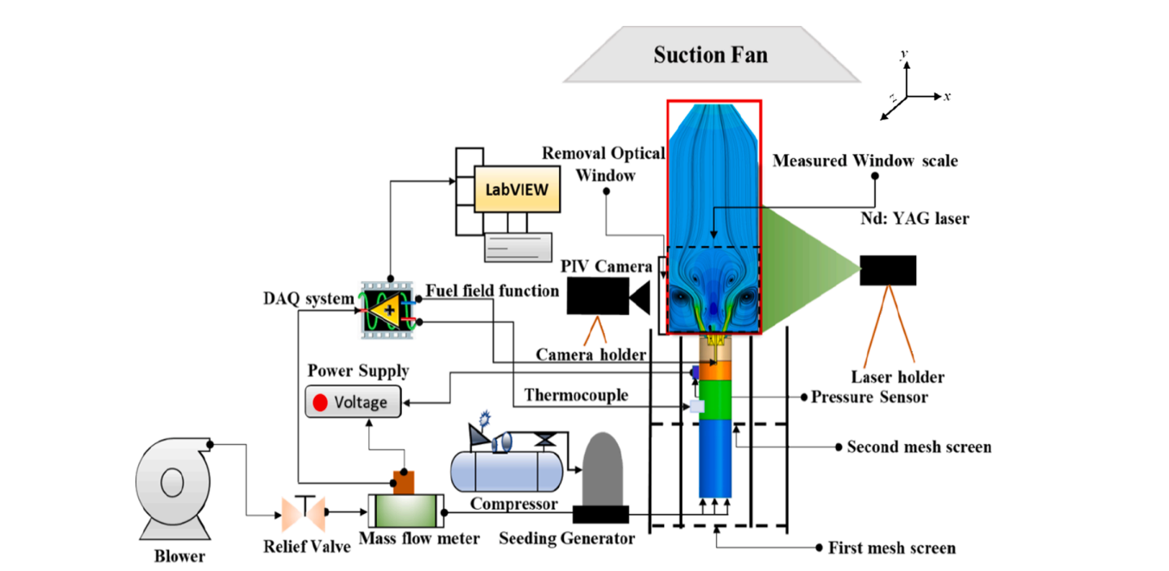
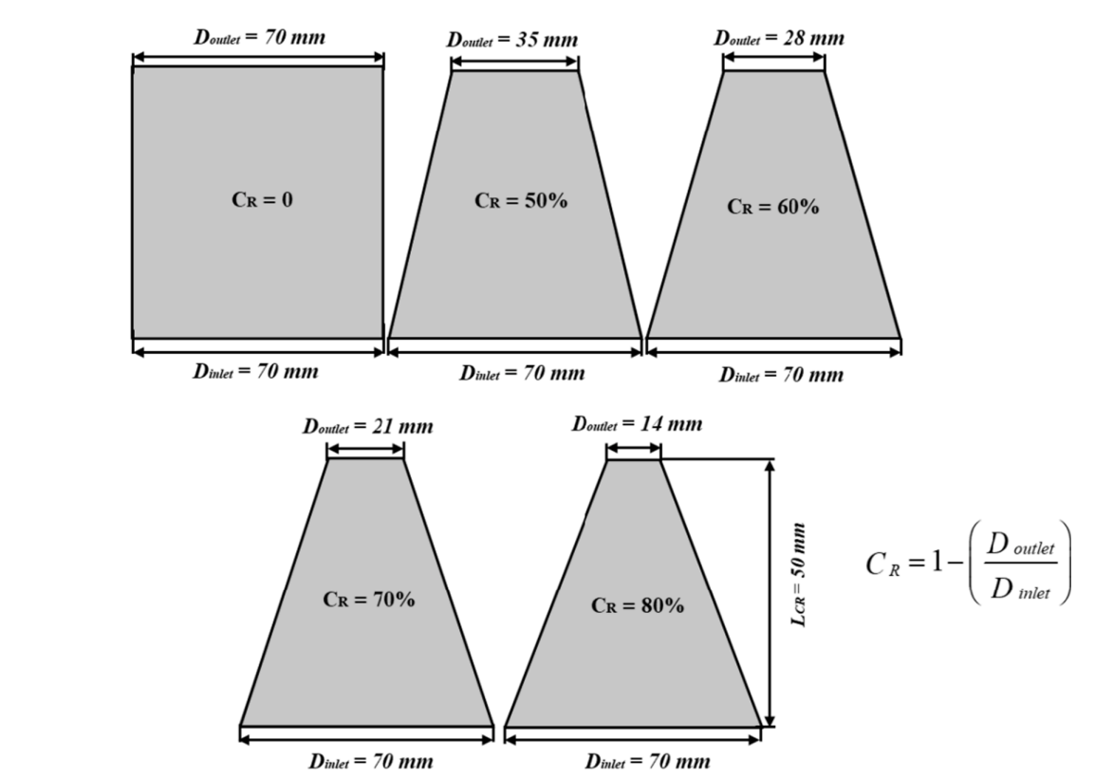
Experimental setup:
2.1. The model combustor

Slide 7
To compress the main air, a ring blower (HRB-1000, 60 Hz, Power: 12.6 kW, Max. air flow: 10 m3 / min, Hwanghae Electric Co., Korea) is used.
Mass flow meter (MFM (FESTO–151694 MPYE-5–1/4–010-B, Germany))
pressure sensors (BM-1100-50G with an accuracy of ± 1 % FS, Kulite, USA) were con nected to the DAQ system to measure the pressure through the LabVIEW program.
An electric ball compressor (F-117-CI-BGD-15-V, Pressure rating: 100 bar, Range: 0–1000 m3 /h, Bronkhorst, Germany) is used to provide the secondary air to simulate gaseous fuel injection and it is controlled by the mass flow controller (MFC).

Slide 8
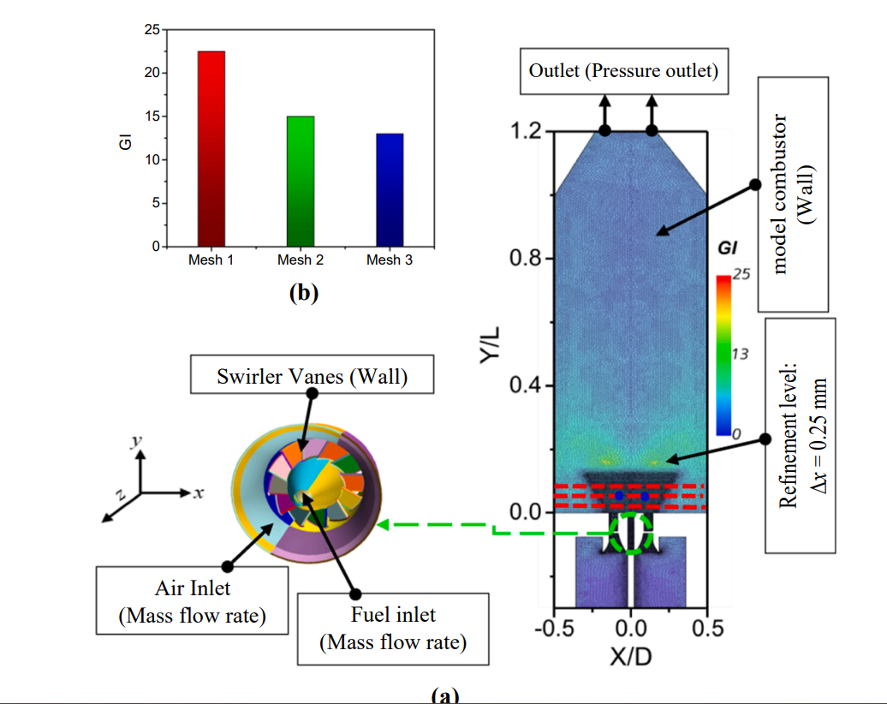
Dimensions:
l = 250 mm ,D_{inlet}= 70 mm, The axial swirler (Do = 20 mm, Dh = 12 mm) has 12 symmetrical blades with fixed angle of θ = 39◦ where the flow cross-sectional area (Asection) of 4,900 mm2 , and the aspect ratio (S) of 1 as presented in Fig. 2 (a).

Slide 9
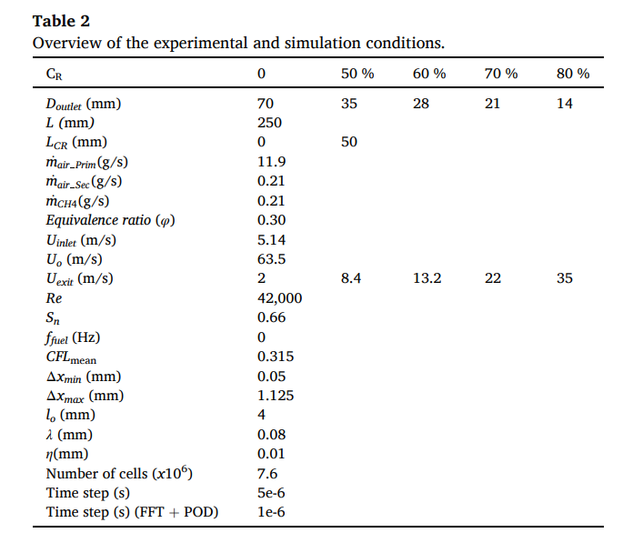
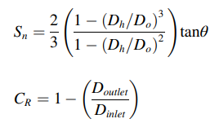
In all experimental cases, there are two air inlets, where the first one passes through the plenum at a rate of 11.9 g/s, and the second one passes through the fuel nozzle at a rate of 0.21 g/s.
The corresponding Reynolds number of the main air in the plenum was considered a constant for all CRs and was approximately 42,000.

Slide 10
2.2. PIV system:
The system consisted of a double pulse Nd:YAG laser (maximum energy of 120 mJ/pulse, 15 Hz, pulse width of 8 ns, BigSky laser Co., USA), a CCD camera (Power View Plus 4 with an MP resolution of 2.04 K × 2.04 K pixels and a speed of 16 fps in frame straddling mode, with a frame straddling time of 200 ns, Dantec Co., Denmark), and a synchronizer controlling the laser pulse and camera shutter timing (Laser Pulse Synchronizer 610034, Dantec Co., Denmark) that triggers a signal to the controllers.
The time interval between every-two consec utive pulses of the laser sheet was equal to dt = 5 μs, which was determined to limit the plane particle displacement between successive illuminations.
The thickness of the laser sheet formed by the cylindrical lens was 1 mm.
The particles (Di-Ethyl-Hexyl-Sebacat, DEHS) with a diameter of 1–3 µm and a relaxation time of 11 µs were seeded into a swirling flow field. The particle density and dynamic viscosity were 900 kg/m3 and 19–23 mPa.s.
Here, the Stokes number of the seeded particles is important because if the Stokes number is large, the particles cannot follow the fluid due to their inertia.
If the Stokes number is<1, the particle moves with the fluid, and if it is<0.1, it is known that a tracing error of 1 % or less occurs.
The Stokes number of the tracer particles used in this study was 0.0003323, which was significantly smaller than 0.1.

Slide 11
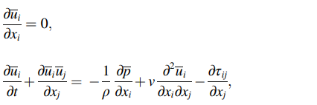


Numerical approaches
3.1. Governing equations:
The Mach number is considered to be<0.15.The governing equations are approximated by the
Navier–Stokes equations for incompressible flows.
In LES, the governing equations are spatially filtered and can be written as follows:
u_{i}is the filtered velocity component along the Cartesian coordinatesxi,
p denotes the filtered pressure,
ρ is the fluid density,
v is the kinematic viscosity of the fluid and
τ_{ij}is the SGS stress tensor component
The SGS stresses are linked to the eddy viscosity vt and the large-scale strain rate tensor Sij by the following equation:

Slide 12
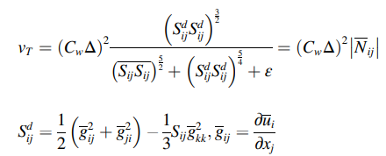
The WALE (Wall-Adapting Local Eddy-viscosity) SGS model [30] is applied in this study, which is considered one of the main SGS models.
The eddy viscosity is expressed by the following:
C_{w}is the WALE model coefficient, which equals 0.544 in this study,
Δ is the cell size,
Δ = (ΔxΔyΔz)^{1/3}[32], and
ε = 10⁻⁶.

Slide 13
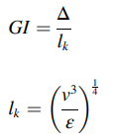
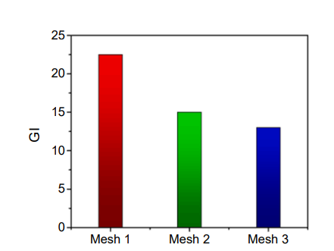
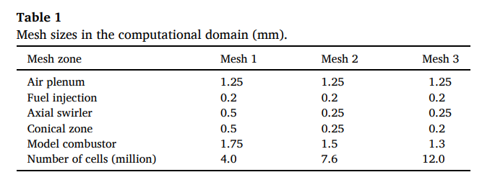
3.2. Mesh generation and boundary conditions :
Table 1 provides details regarding the three generated meshes with 4.0 × 10⁶, 7.6 × 10⁶and 12.0 × 10⁶cells
The GI is the relation between the local grid size (Δ) and the Kolmogorov length scale (lk), and it is defined as follows:
GI is<25

Slide 14
The Taylor microscale (λ) and the Kolmogorov length scale (l_{k}) were investigated using the unsteady Reynolds-averaged Navier–Stokes (U-RANS) approach based on a coarser mesh (4.0 × 106 ).
The Realizable k-ε was applied in the URANS simulation to determine the appropriate local grid size (Δ), which is located between the Taylor microscale (λ) and the Kolmogorov length scale (l_{k}) [30,33,37].
It is found that the Realizable k-ε predicts well the swirling flow where the recirculation zones and the pressure gradients are significantly formed.
Furthermore, it can be used in flows with high separation and large strain rates, however, the predictions of vortex shedding and the PVC frequencies were not in agreement with the ex periments [38,39].
The CH4 inlet is 50 mm inwards after the main air inlet. Inflow boundary conditions for the main air and CH4 inlets were applied as constant uniform mass flow rates (11.9 g/s for air and 0.21 for CH4).
The spatial discretization for all the simulation cases was performed using the second-order of bounded central differencing in the STAR CCM + package [40], which is an ideal choice for LES due to the low numerical diffusion.
All simulation cases were performed with a constant time step of Δt =5×10⁻⁶s, such as the experimental setup, and Δt =1×10⁻⁶s for FFT and POD analysis to capture the PVC structure and dynamics. The Courant–Friedrichs–Lewy (CFL) is 0.315 to stabilize LES calculations. The LES data are collected for approximately 0.15 to 0.20 s, which corresponds to a 2,500-time step characteristic of the flow-through-time

Slide 15
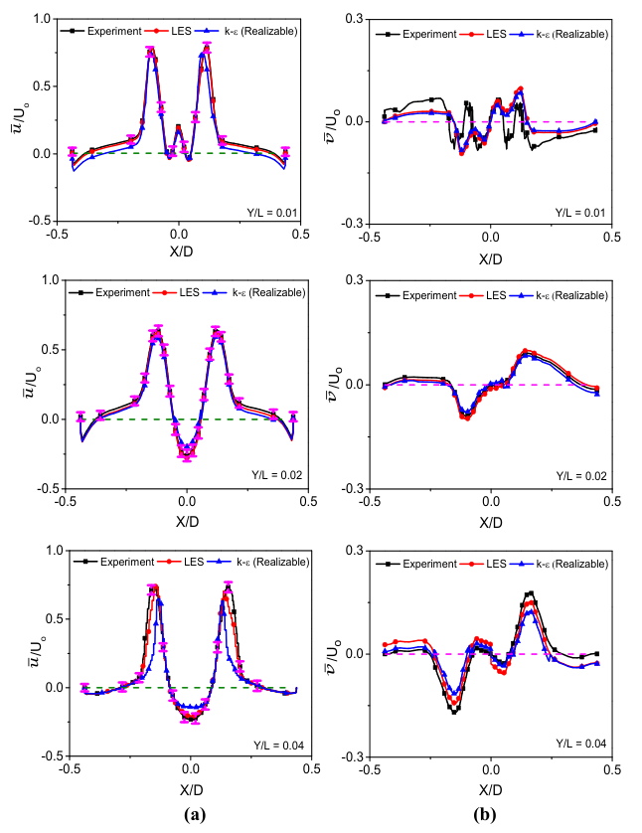
3.3. Validation process:
The basic error between PIV and LES is sufficiently small and PIV measures the flow statistics accurately due to the low pass filtering related to the size of the interrogation area.
However, LES gives a slightly deviated smaller than the PIV results by 4.8 % for the normalized mean radial velocity profile at Y/L = 0.01 because the turbulence is strongly anisotropic in this certain region of the model combustor.

Slide 16

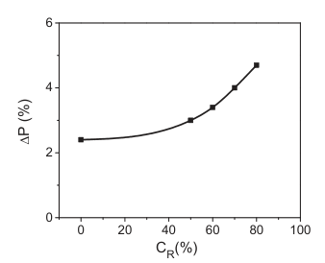

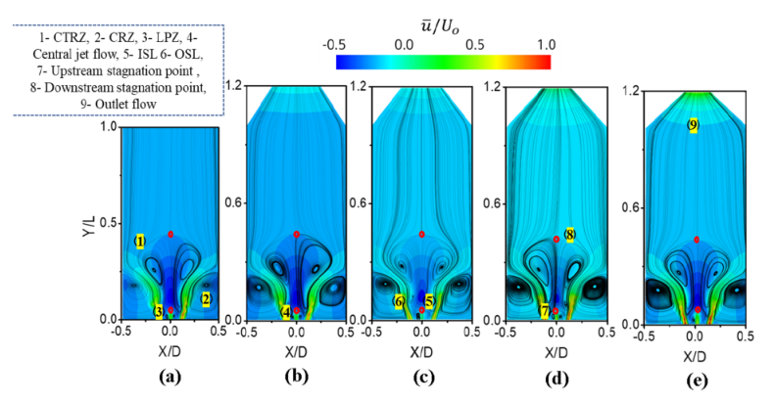
Results and discussion
Effect of CR on the mean flow characteristics:
The velocity ratio between the swirler exit velocity (Uo) and central jet velocity (Vj) is 3.5. This region extends to −0.03 < X/D < 0.03 and 0 < Y/L < 0.02. Two small antisymmetric lip recirculation zones (LPZs) are formed around the exit of the fuel nozzle along the axial direction of the combustor. The LPZ is obviously dominant for CR = 0, 50 % and 70 %; however, only one side appeared for CR = 60 % and 80 %

Slide 17
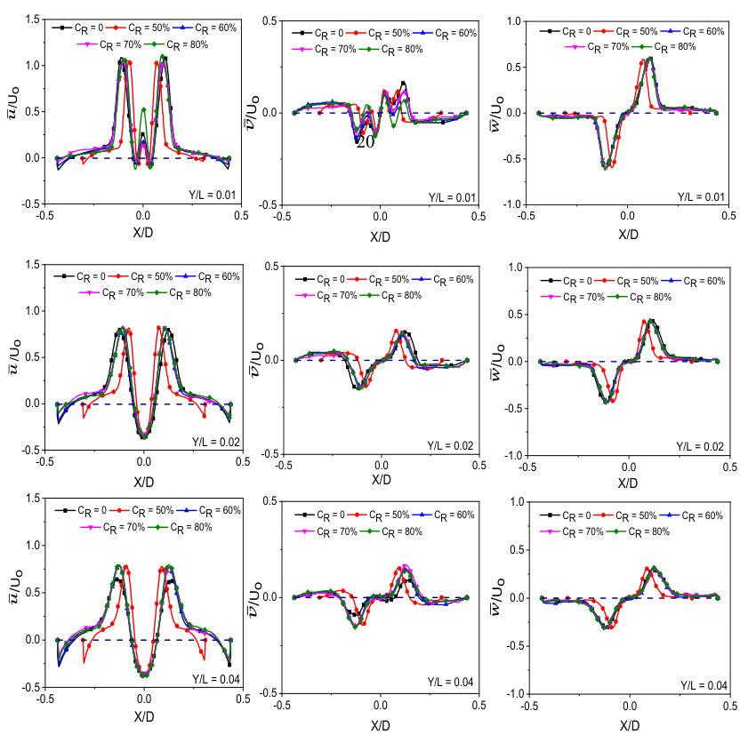
All CR cases are approximately the same,with a maximum deviation of 2 % for CR = 0 and 80 %.

Slide 18
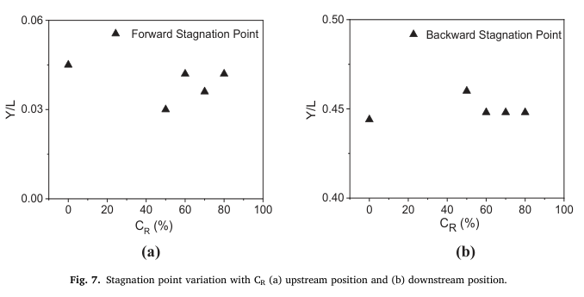
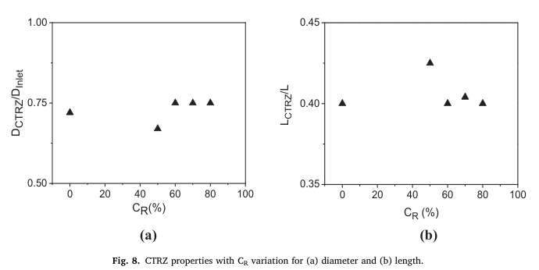

The stagnation point variation is nearly in the range of X/D = ± 0.0025 in the x-direction, and it takes place along the centerline of the combustor due to the pressure gradients.
In Fig. 8. The diameter of the CTRZ with CR is calculated using Eq.

Slide 19

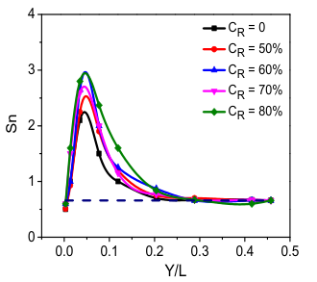

Rc is the radius of the model combustor and
r is the swirling flow radial coordinate.
The swirl numbers significantly increase in the range of 0.02 < Y/L < 0.1. This behavior can be related to the formation of CTRZ.
In this zone, the peak values of the swirl number are almost 3 for CR = 60 % and 80 %, while they are still higher in the ranges from 2.2 to 2.7 for the other CR cases
The higher swirl dissipation rate in this zone leads to an improved mixing process among the air and fuel streams.
The swirl number for all CR cases decreases to 0.66 in the downstream region due to the velocity distribution vanished by the bubble vortex breakdown.

Slide 20
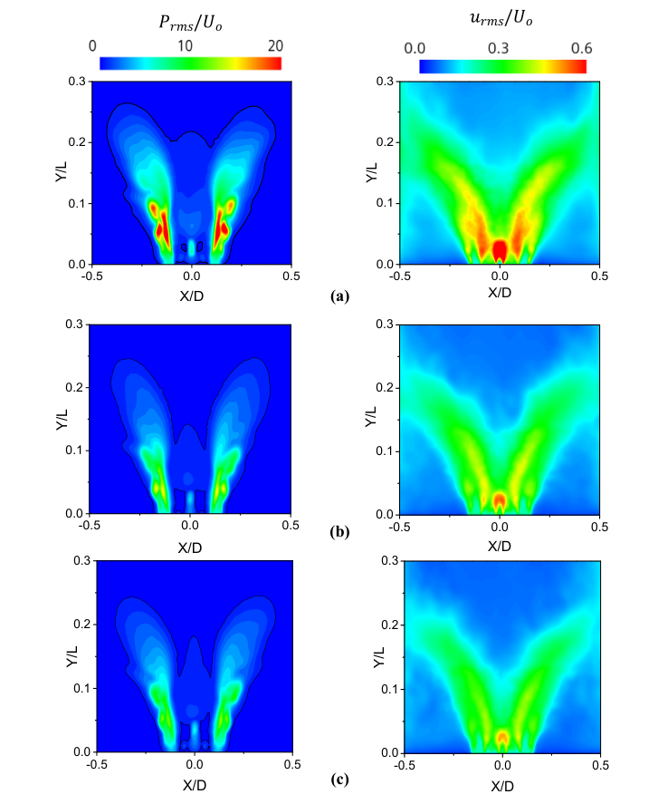
Effect of CR on the turbulent flow characteristics
The maximum fluctuation of pressure occurs at the OSL between 0.04 < Y/L < 0.1 and ± 0.05 <X/D<±0.075 for CR = 0, and its magnitude is 15Uo.
ForCR = 50 % the pressure fluctuations are suppressed with a magnitude of 13Uo, and it is more clearly observed at the OSL thickness, as plotted in Fig. 10 (c).
The rms pressure values decrease up to 10 Uo, which also reflects the OSL thickness for CR = 60 %, 70 % and 80 %
The maximum rms appears in the central jet and ISL regions, especially for CR = 0, and higher rms values are observed in the ranges of 0.02 < Y/L < 0.15 and−0.06 < X/D < 0.06, however, the minimum rms was at the OSL in the ranges of 0.04 < Y/L < 0.07 and −0.1 < X/D < 0.1
With increasing CR, the swirling flow was strong and spread well causing a decreased situation for the rms velocity fields which can simulate the presence of anisotropy in the turbulent field as shown for CR = 60 %.
The rms values decrease significantly for CR=60 %,70% and 80% and consequently, the mixing region increases due to the stability of the bubble vortex breakdown phenomena acting as a central bluff body.

Slide 21

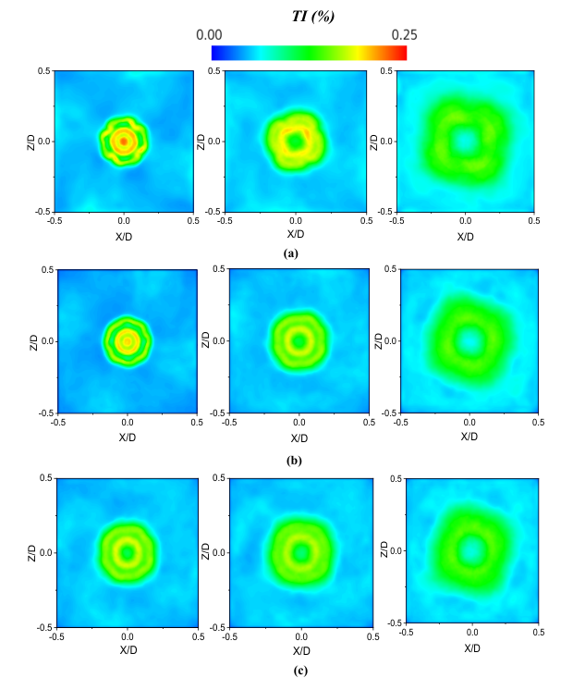
k is the turbulent kinetic energy and Uo is the axial velocity of the jet at the model combustor inlet.

Slide 22
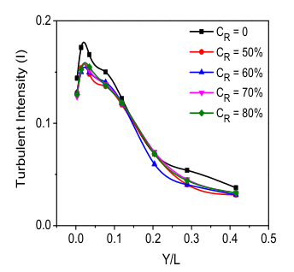
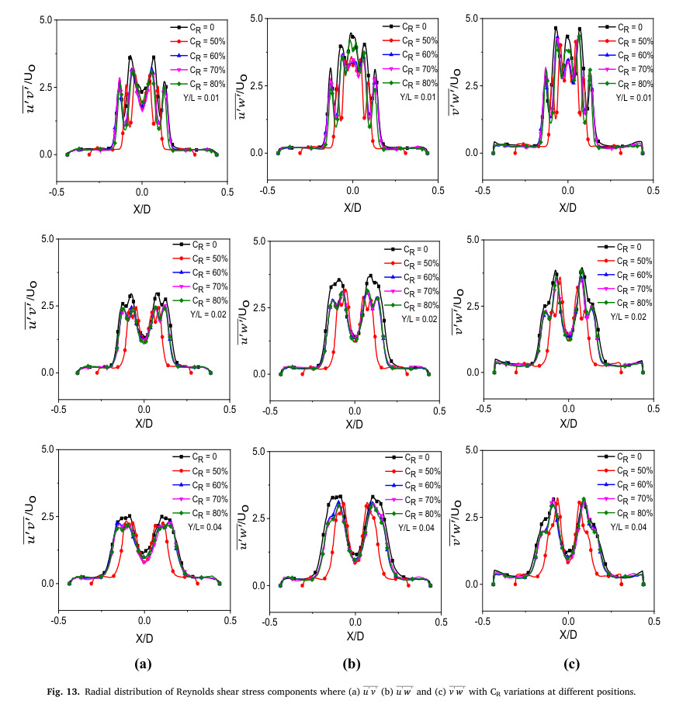

Fig. 12 shows the axial distribution of the turbulence intensity, in which the maximum value is 18.5 % for CR = 0 at Y/L = 0.05. With increasing CR, the turbulence intensity decreases to 16 % for CR = 50 %,70 % and 80 %
The Reynolds shear stress is high in the range of−0.15 < X/D < 0.15, where the shear layers region (see Fig. 11) and the formation of CTRZ are located for all CR cases.

Slide 23
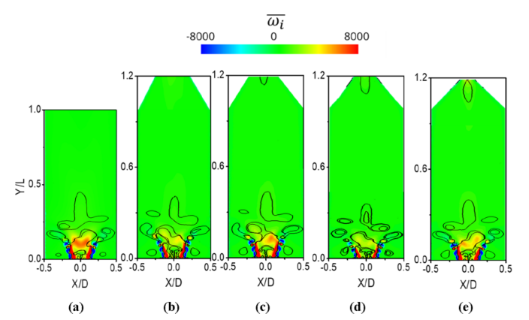

Effect of CR on the turbulent flow characteristics
The Q-criterion is defined as the connected fluid areas with a positive second invariant of the velocity-gradient tensor (expressed as ∇u = S + Ω, where S is the strain rate tensor and Ω is the vorticity tensor), as presented below in Eq.

Slide 24
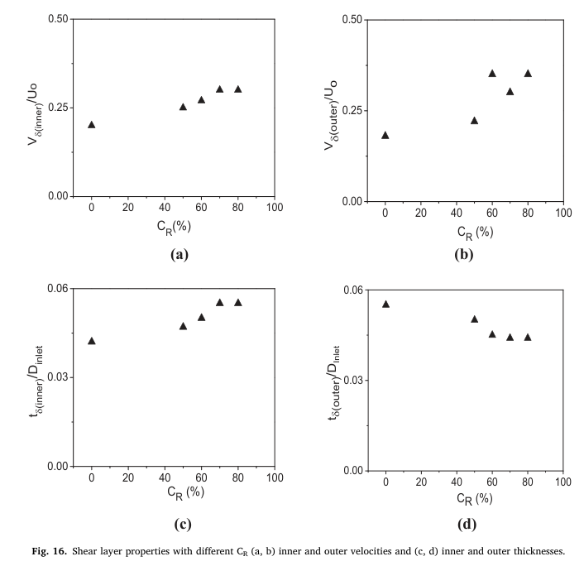
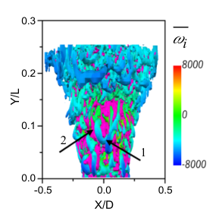

1. Formation of PVC
2. Kelvin–Helmholtz
(K–H) instability

Slide 25
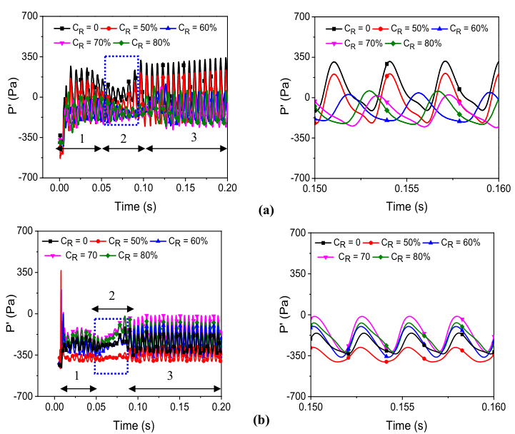
Effect of CR on the vortical structure:
Pressure fluctuation
With the pressure fluctuation signals, the following three phases are determined.
At the beginning, phase one which is characterized by a linear growth phase between 0 s and 0.05 s.
Then, phase two which is a transitional stage between decay and growth ranging from 0.05 s to 0.1 s (see blue box – Fig. 17).
Finally, phase three which is a stable harmonic phase extending from 0.1 s to 0.2 s
The signal recorded maximum and minimum fluctuations for CR = 0 at a phase angle (θ) of ~ 90◦.
The minimum fluctuations occur for CR = 70 % and 80 % at an θ of ~ 270◦.
With increasing CR, the pressure fluctuations are suppressed until the maximum, and minimum peaks are constant for CR = 60 %, 70 % and 80 % (see Fig. 17 (a) – right side).

Slide 26
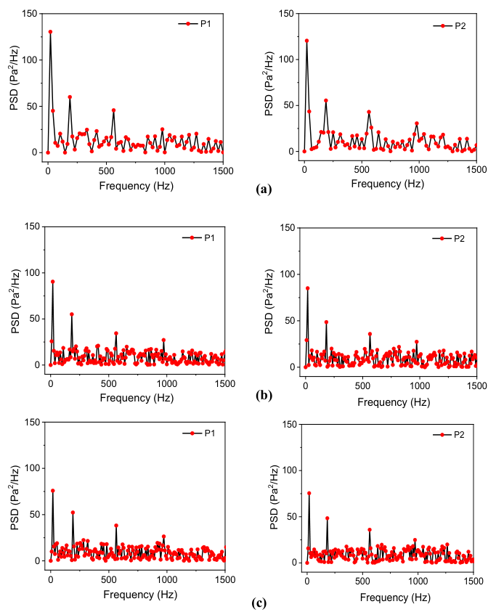

Slide 27
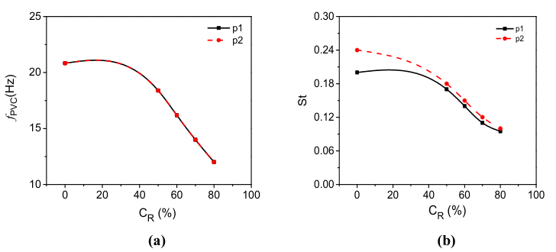
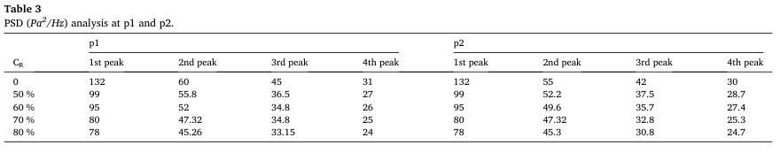


Slide 28
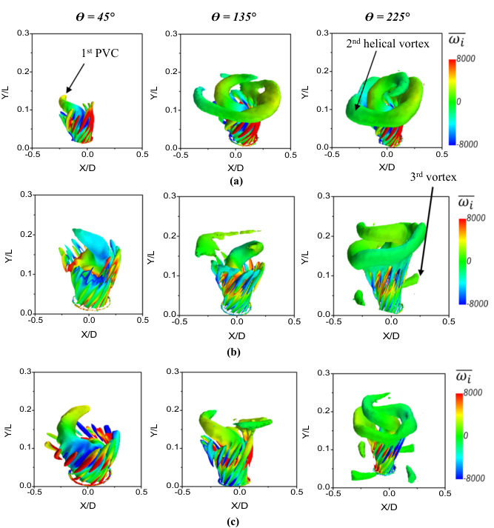
The spiral motion covers 0.45 D_{inlet} and extends throughout the range of 0.004 ≤ Y/L ≤ 0.12 for CR = 0. By applying the CR to the model combustor, the PVC radially and longitudinally stretches to the 0.55 D_{combustor} in the range of 0.004 ≤ Y/L ≤ 0.17.
The second spiral vortex originating in the OSL surrounding the PVC is depicted obviously at ¨Í = 225º for all CR cases. The second spiral vortex is strong only at ¨Í =135º for CR = 0, and this is reflected in the formation of the maximum turbulence intensity in the OSL region.
Third vortex is present upstream at ¨Í = 225◦ for CR = 50 % and raises its rotation by increasing the CR, as shown for CR = 80 %. This rotation occurs around the beginning of the CTRZ.

Slide 29
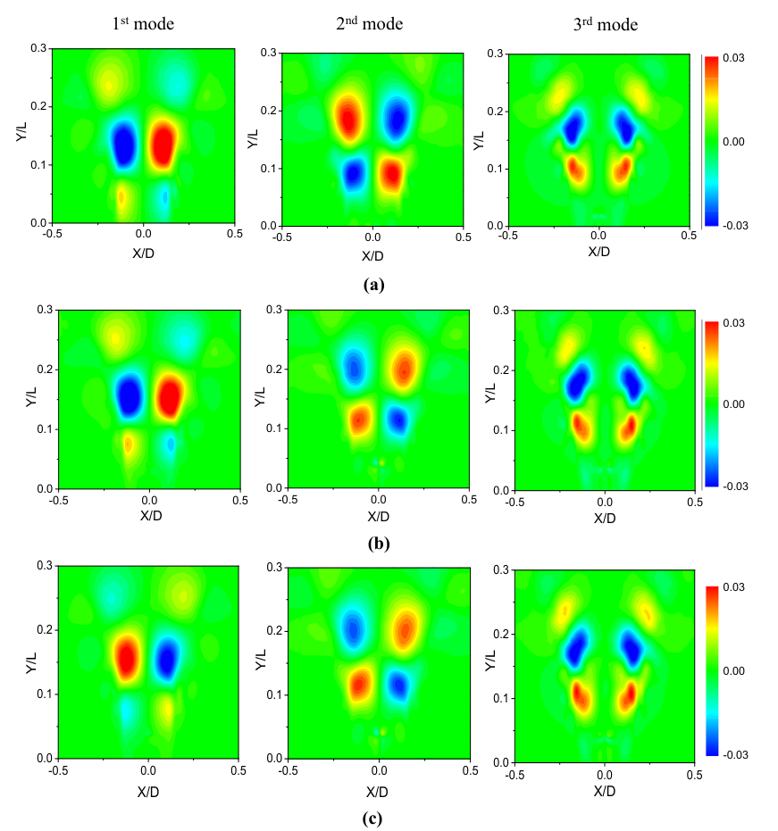
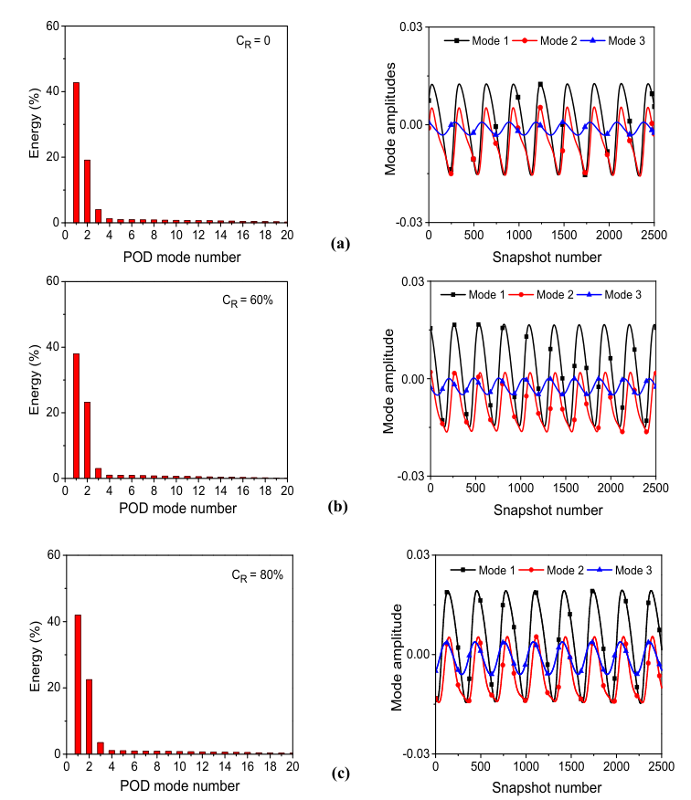

Slide 30
Conclusions
This paper focuses on the vortex breakdown phenomenon properties with various contraction ratio (CR) at the model combustor outlet range as follows :0, 50 %, 60 %, 70 %, and 80 % under constant Reynolds number (Re) of 42,000 and a swirl number (Sn) of 0.66, equivalence ratio (φ) of 0.3 and a normal fuel frequency (ff) of 0 Hz.
Time-averaged results showed that the mean axial velocity increases with an increase in the CR at the contraction part, enhancing the acceleration of the outlet flow and suppressing the adverse pressure gradients by 0.5Uo for CR = 80 %.
A stabilization process is observed for the downstream stagnation point for CR = 60 % to 80 %, representing an equilibrium state for the length of the central toroidal recirculation zone (CTRZ). The CR contributes significantly to increasing the inner shear layer (ISL) velocities and thickness up to 0.32Uo and 0.055Dinlet for CR = 70 % and 80 %, respectively.
The turbulent flow characteristics indicated that the CR reduces the turbulence intensity up to 16 % for CR = 50 %, 70 % and 80 %
Reynolds shear stress distribution decreases in the downstream region by applying the CR to the model combustor.
With increasing CR, the fluctuations in pressure and axial velocity decrease radially toward the centerline of the model combustor; as a result, the thickness of the ISL increases.
The PVC peak decreases gradually with increasing CR. the other three peaks are constant for all CR conditions, and
they are 187 Hz, 562 Hz and 979 Hz.
The strength of the PVC is shown clearly in all CR cases by analyzing the first mode based on the proper orthogonal decomposition (POD) by 40 %. Thus, the energies of the second and third modes are 20 % and 2.8 %, respectively. At this moment, the double-helical structure forms around the OSL with small oscillation amplitudes.

Slide 31


